Slide 1
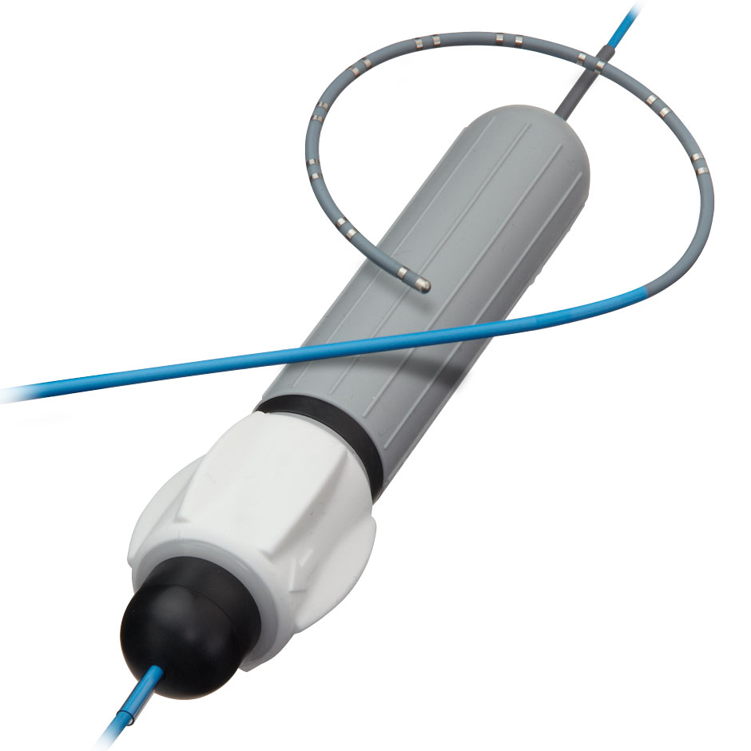
Team 28 Electronically Steerable Catheter
Zane Johnson, Tanner Karbonik, Erin McFadden,
Michael Pass, Matthew Situmeang

Slide 2

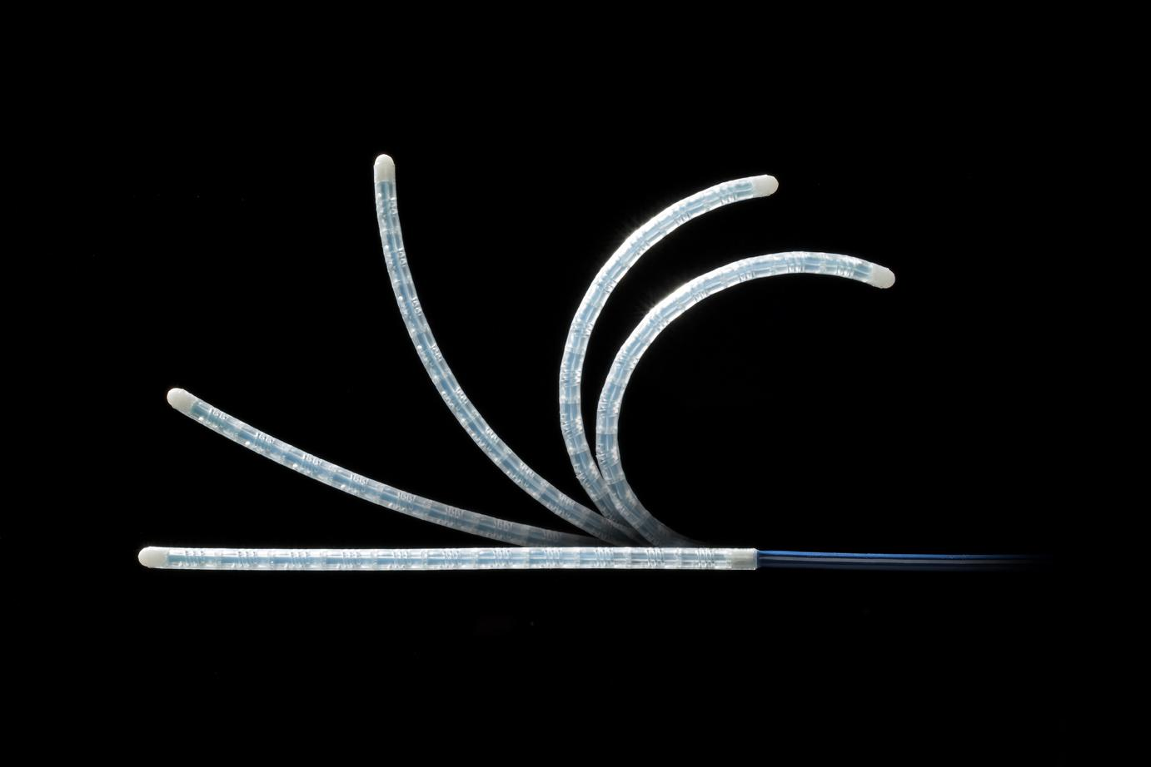
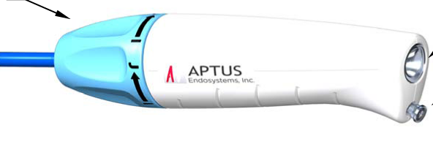
Key Modules:
Electronic Actuation (MCM) | Handle Design/User interface | Power delivery

Slide 3
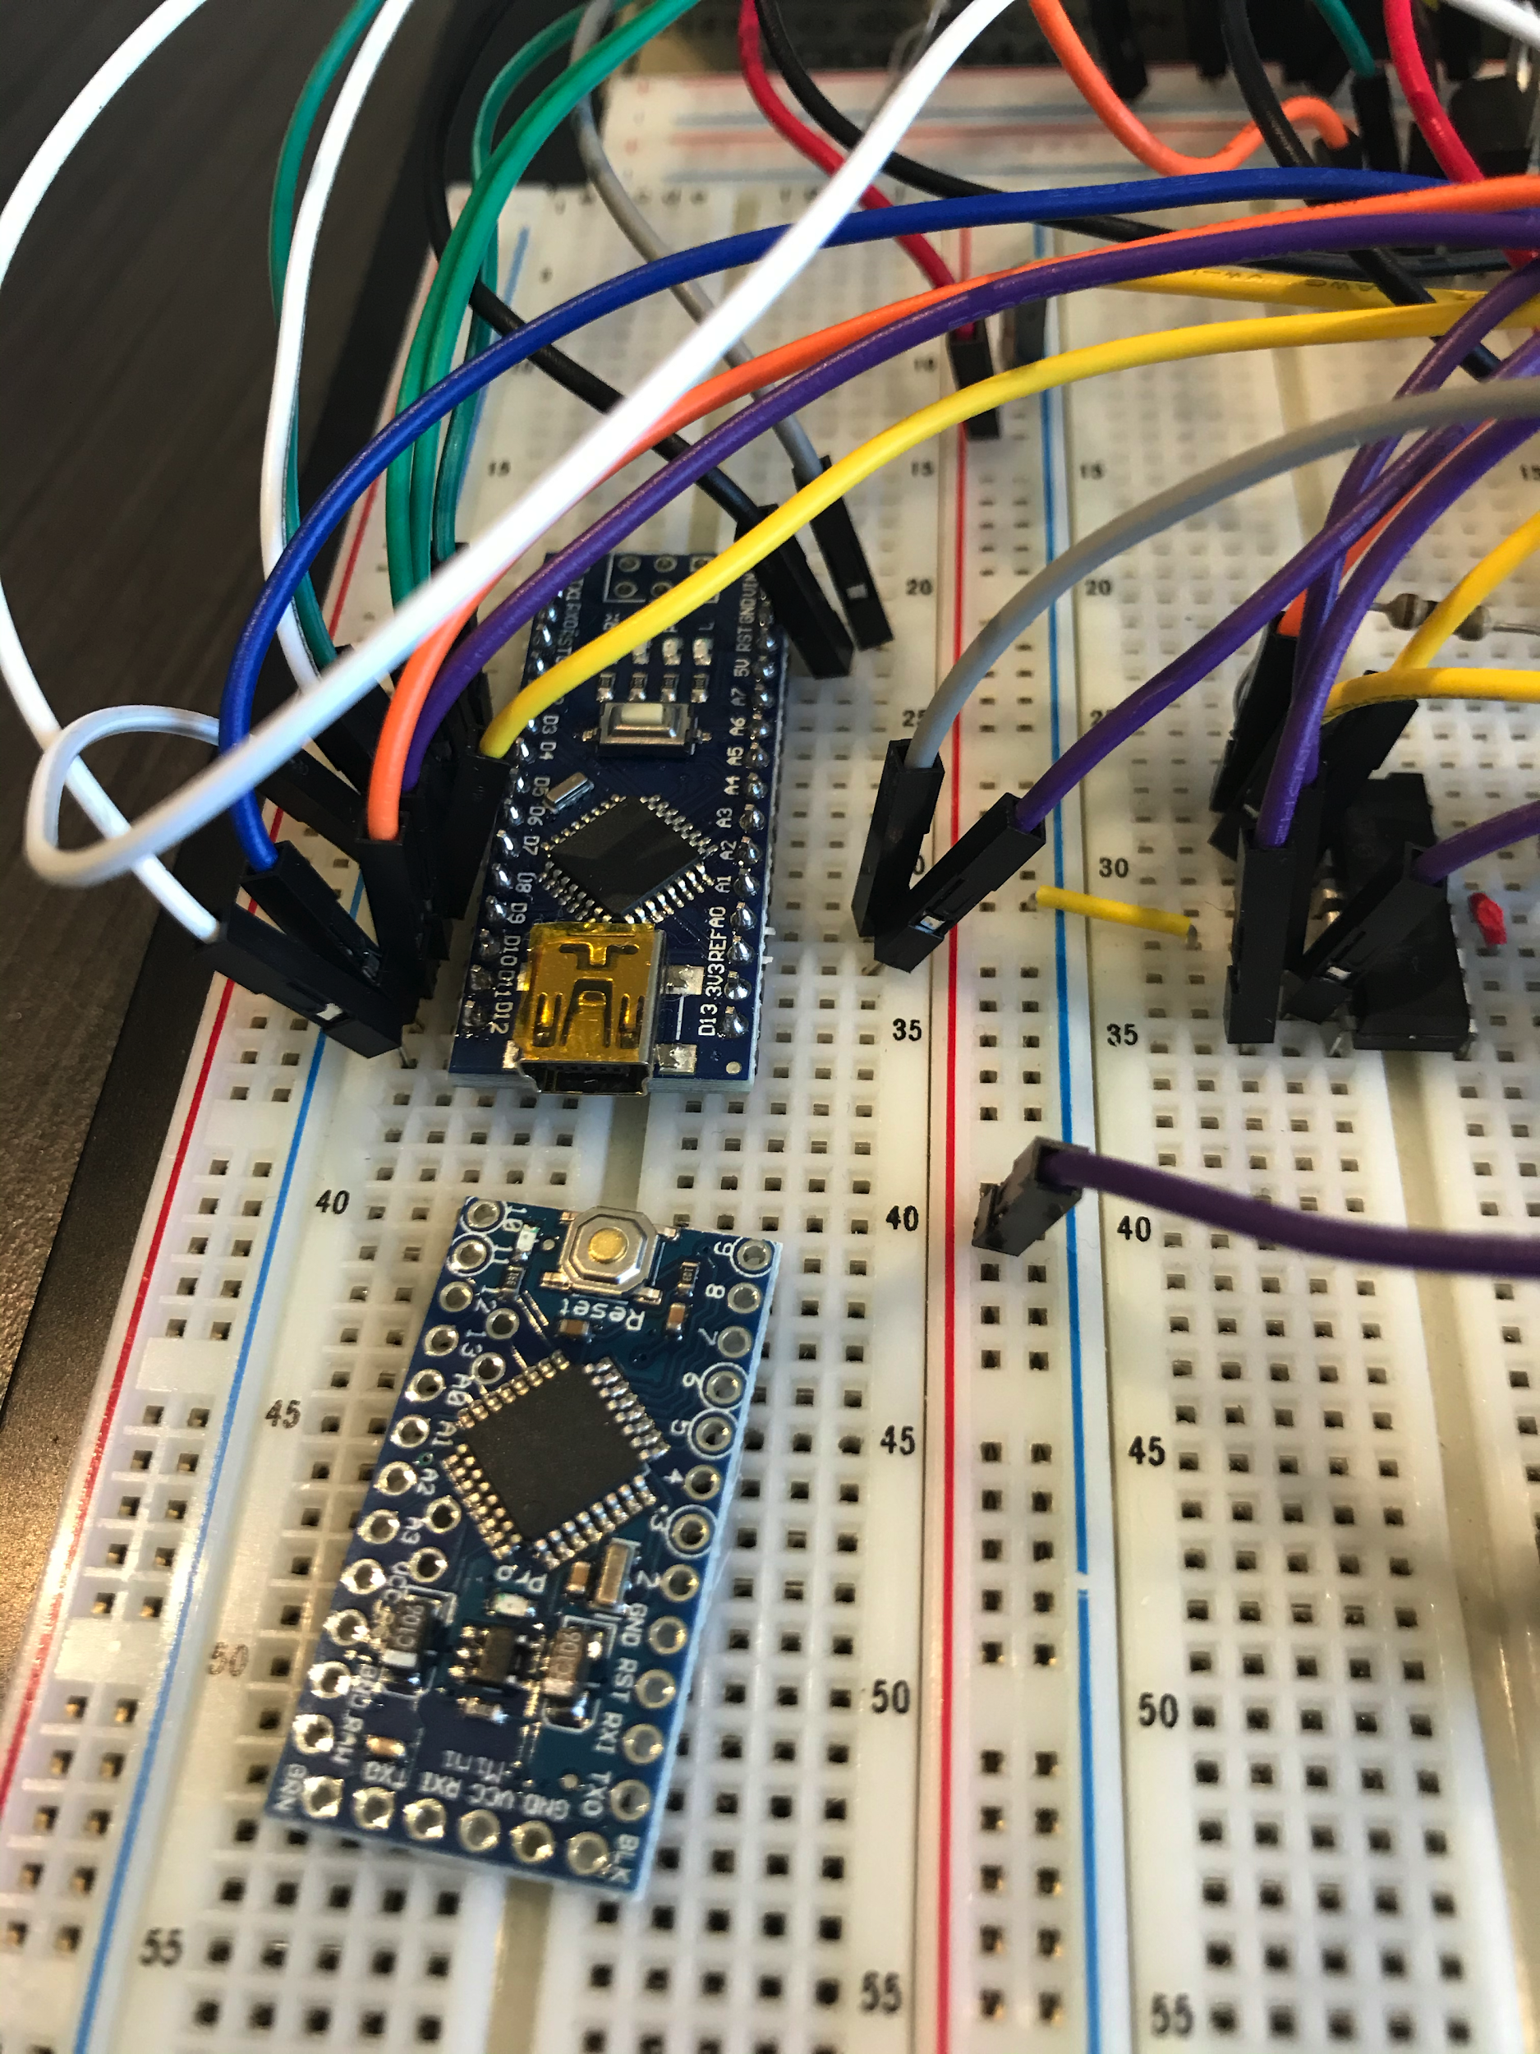
Electronic Actuation - Approach
Routine testing and step-count/angle measurements
Regular commits to GitHub for revision histories
Notes:
Continually test under load.
The polynomial that goes from step count to the actual angle.
We will continue to keep revision history in GitHub.
Routine bench testing under load step-count/angle transfer function
Incremental code development w/ regular commits to GitHub

Slide 4
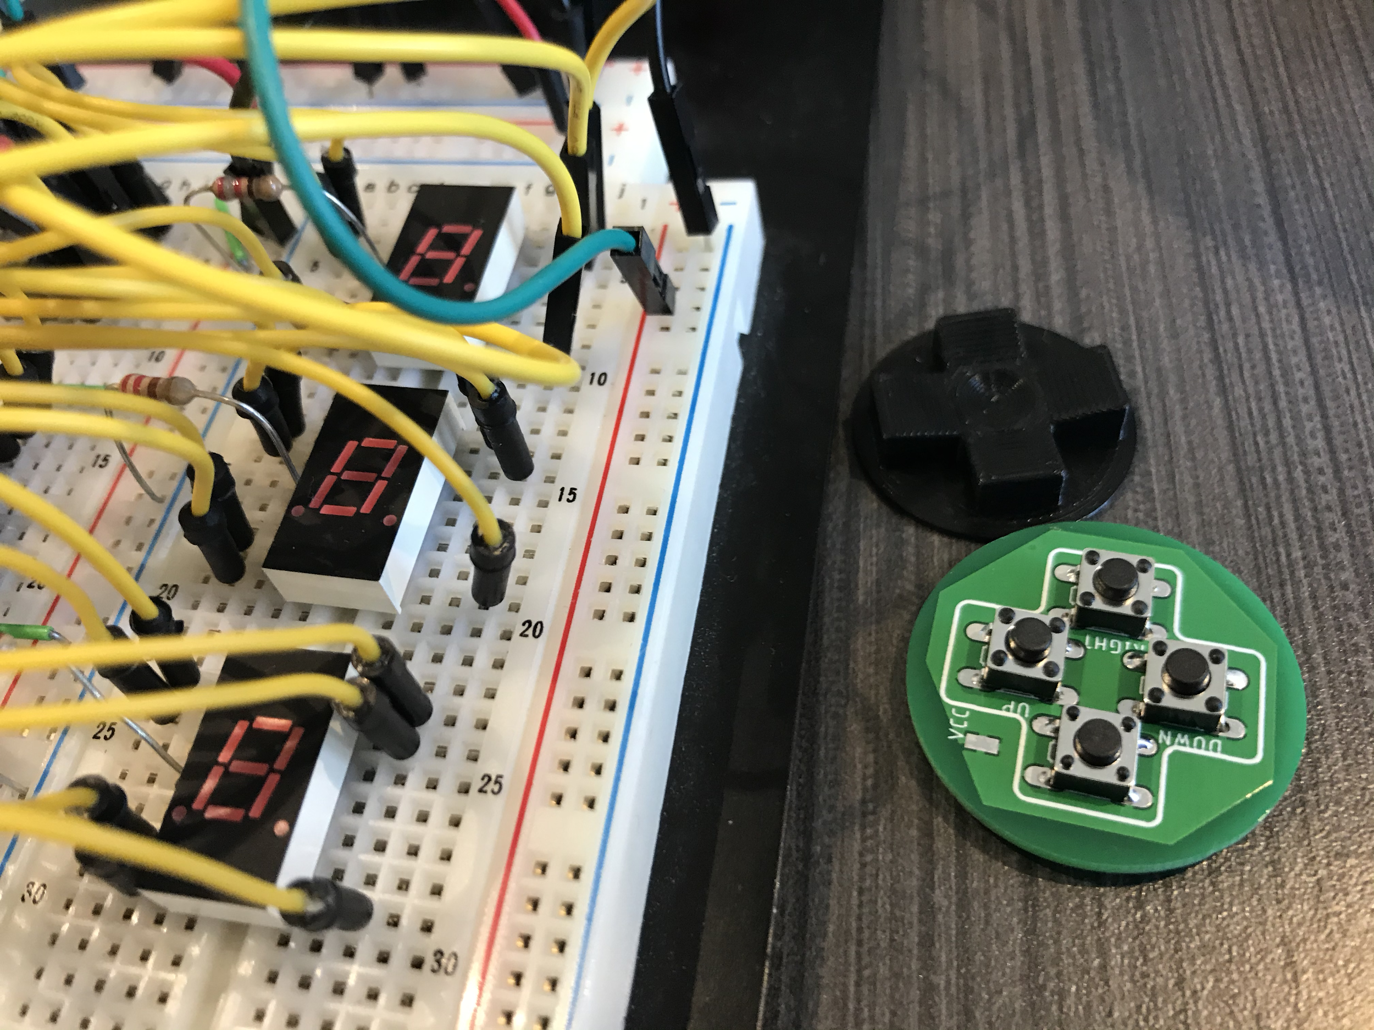
Handle Design/User Interface - Approach
Materials/components research
Inspection of other handles
Regular user-feedback

Slide 5
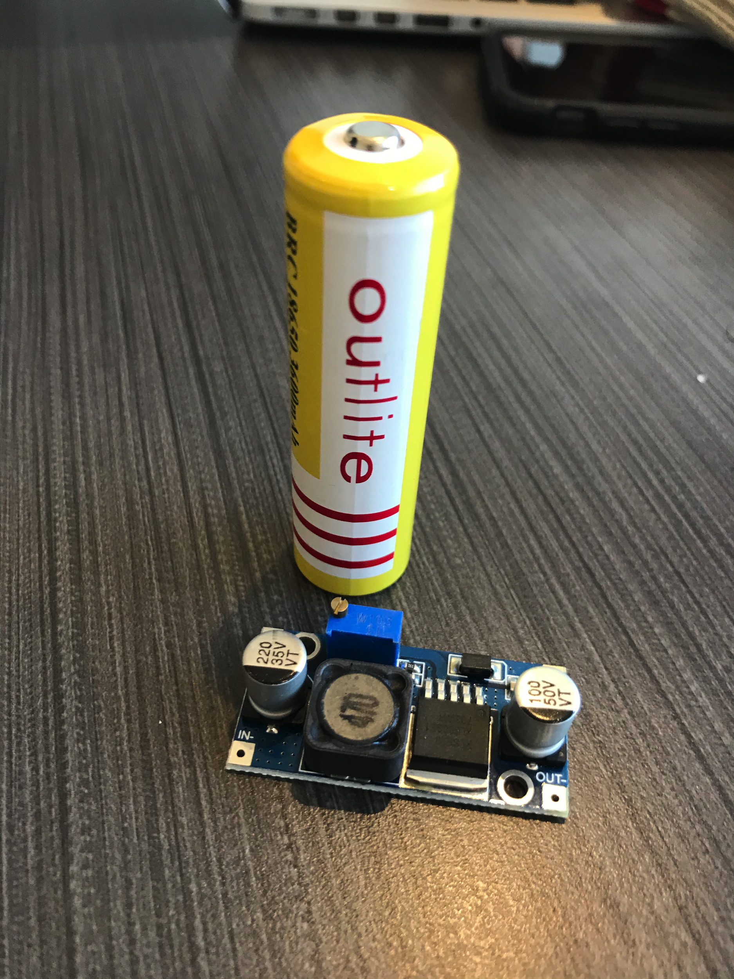
Power delivery - Approach
Monitor power consumption/heat dissipation
Peak power usage determines requirements and lifetime

Slide 6
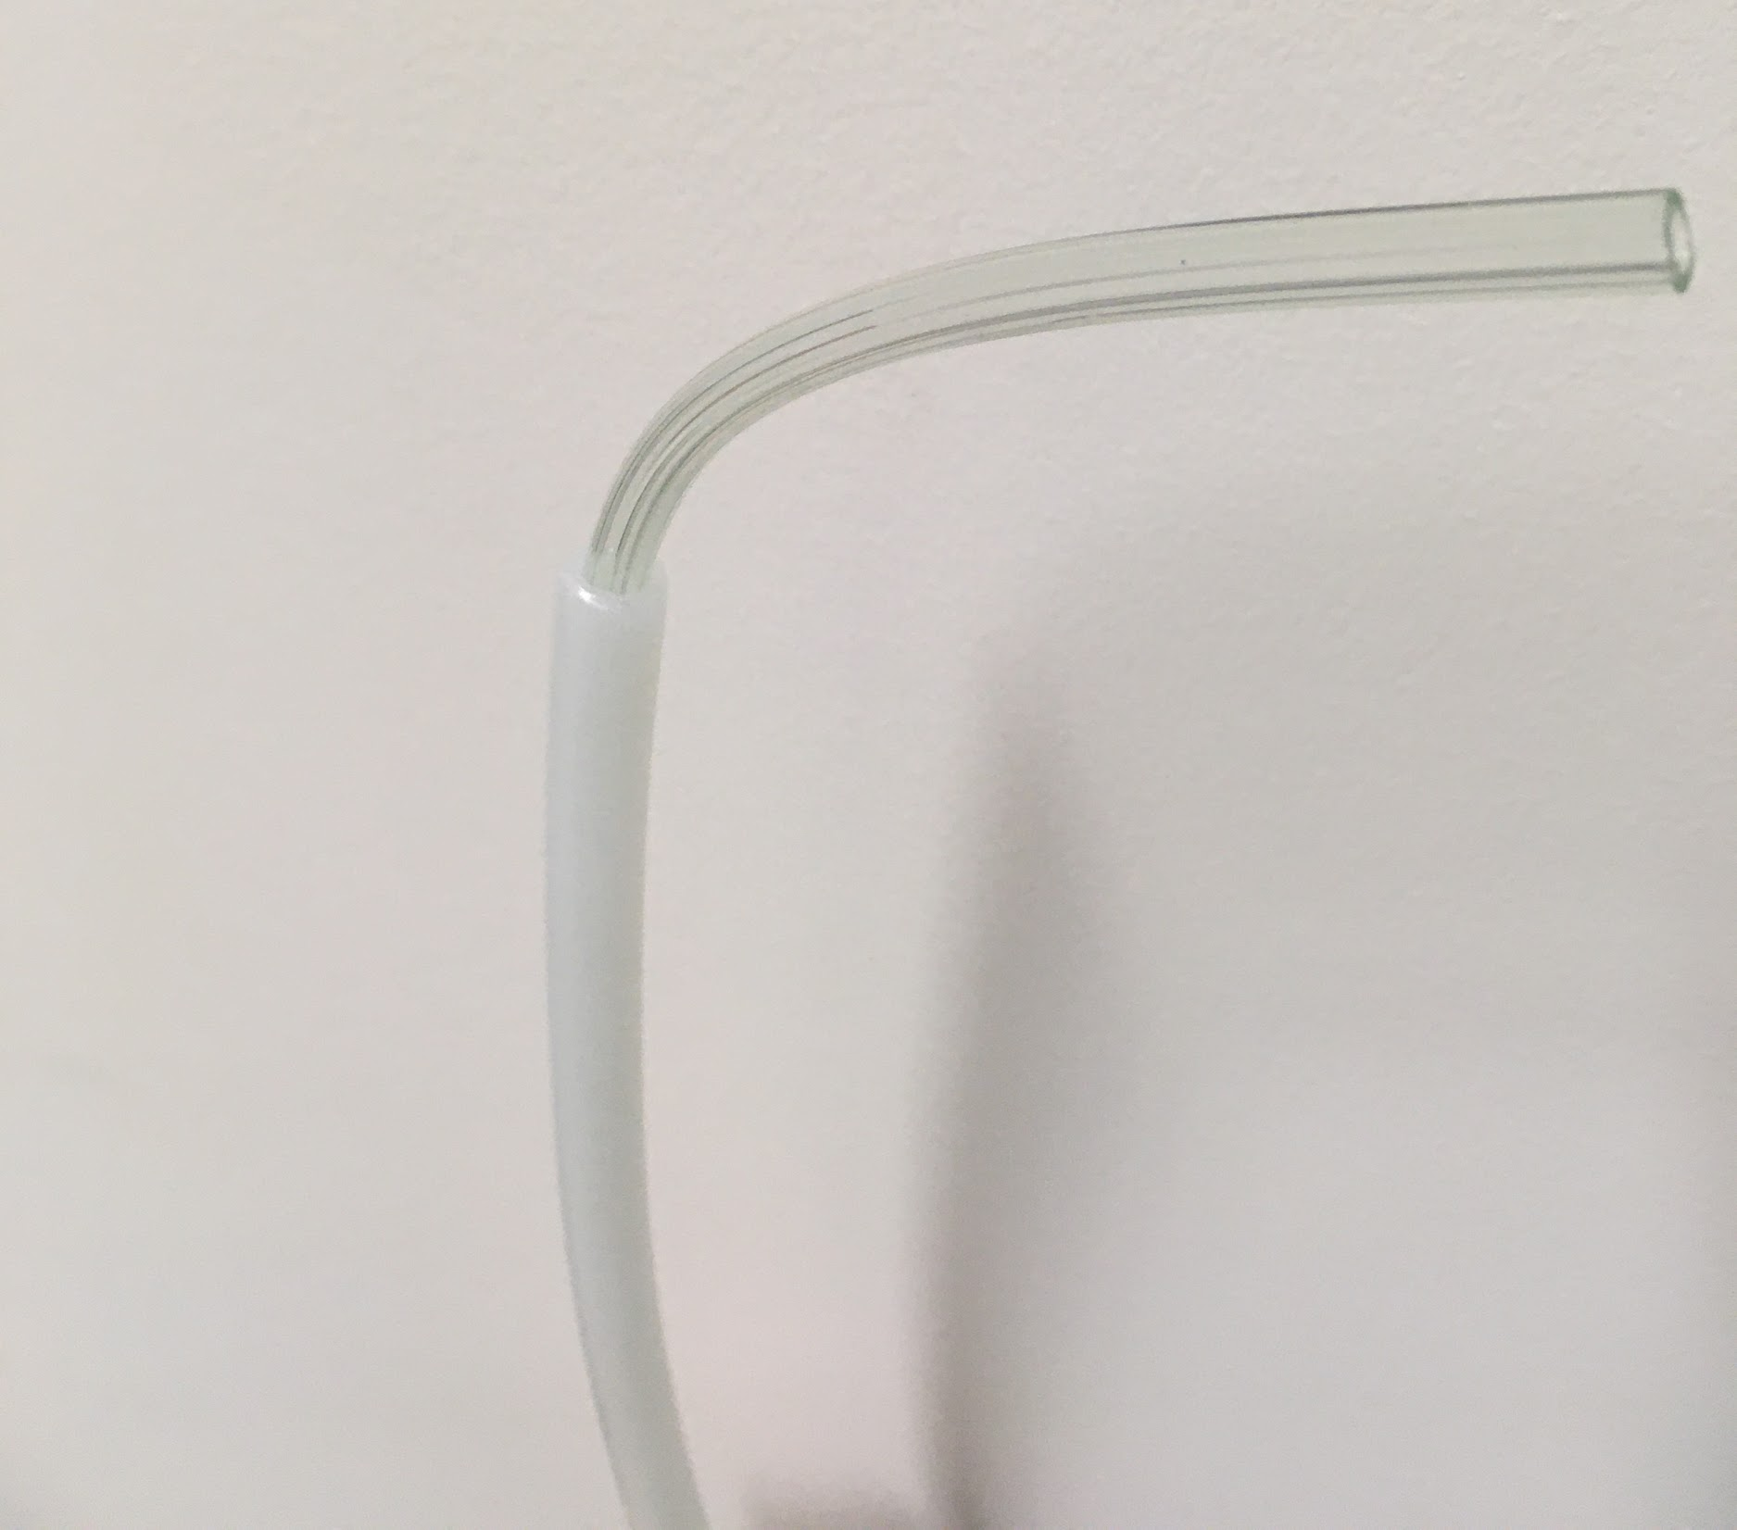
1st Prototype
Flexible inner tubing
Cons
Failed to straighten back to vertical position
Actuated in wrong direction
Single wire attachment
Stiff outer tubing

Slide 7
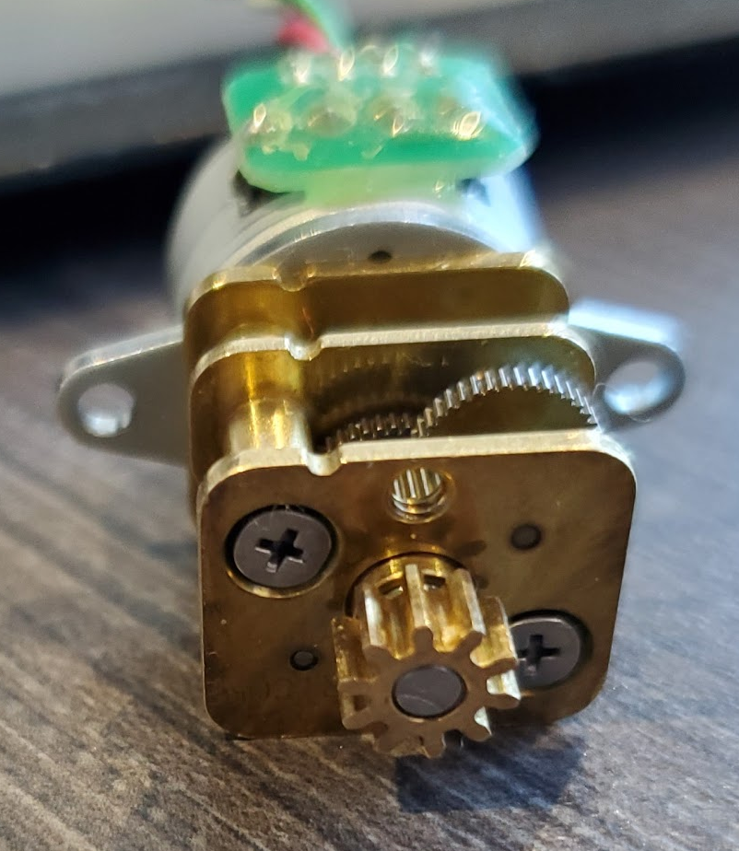
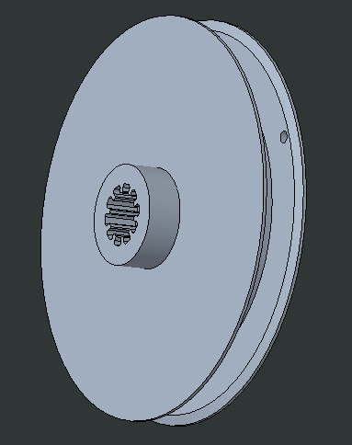
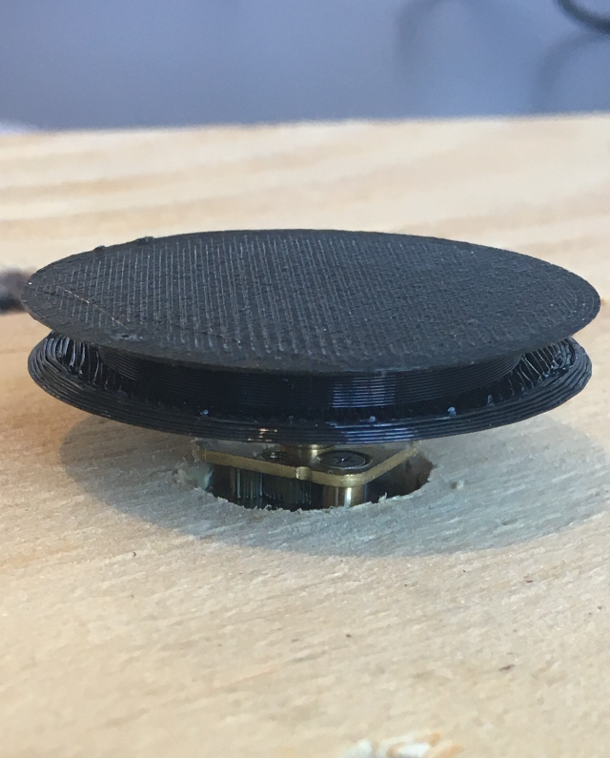
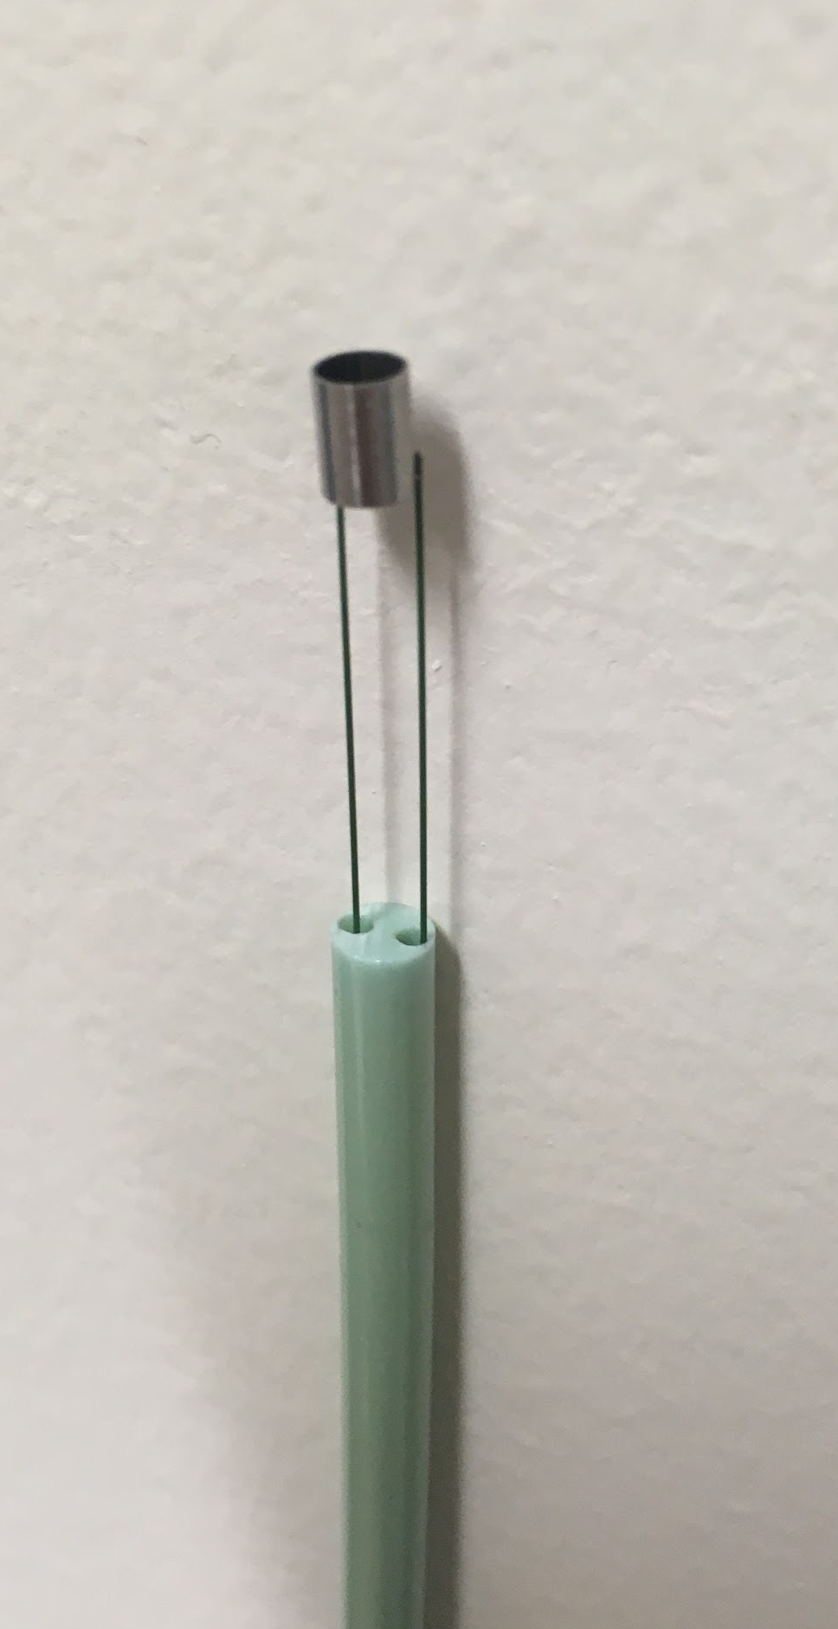
Current Prototype - Can we control the tip of a catheter by spooling the pull wires?
Notes:
Add Pictures of our prototype. Or a short video of the tip bending from manually pulling a wire. Or motor rotation video.

Slide 8
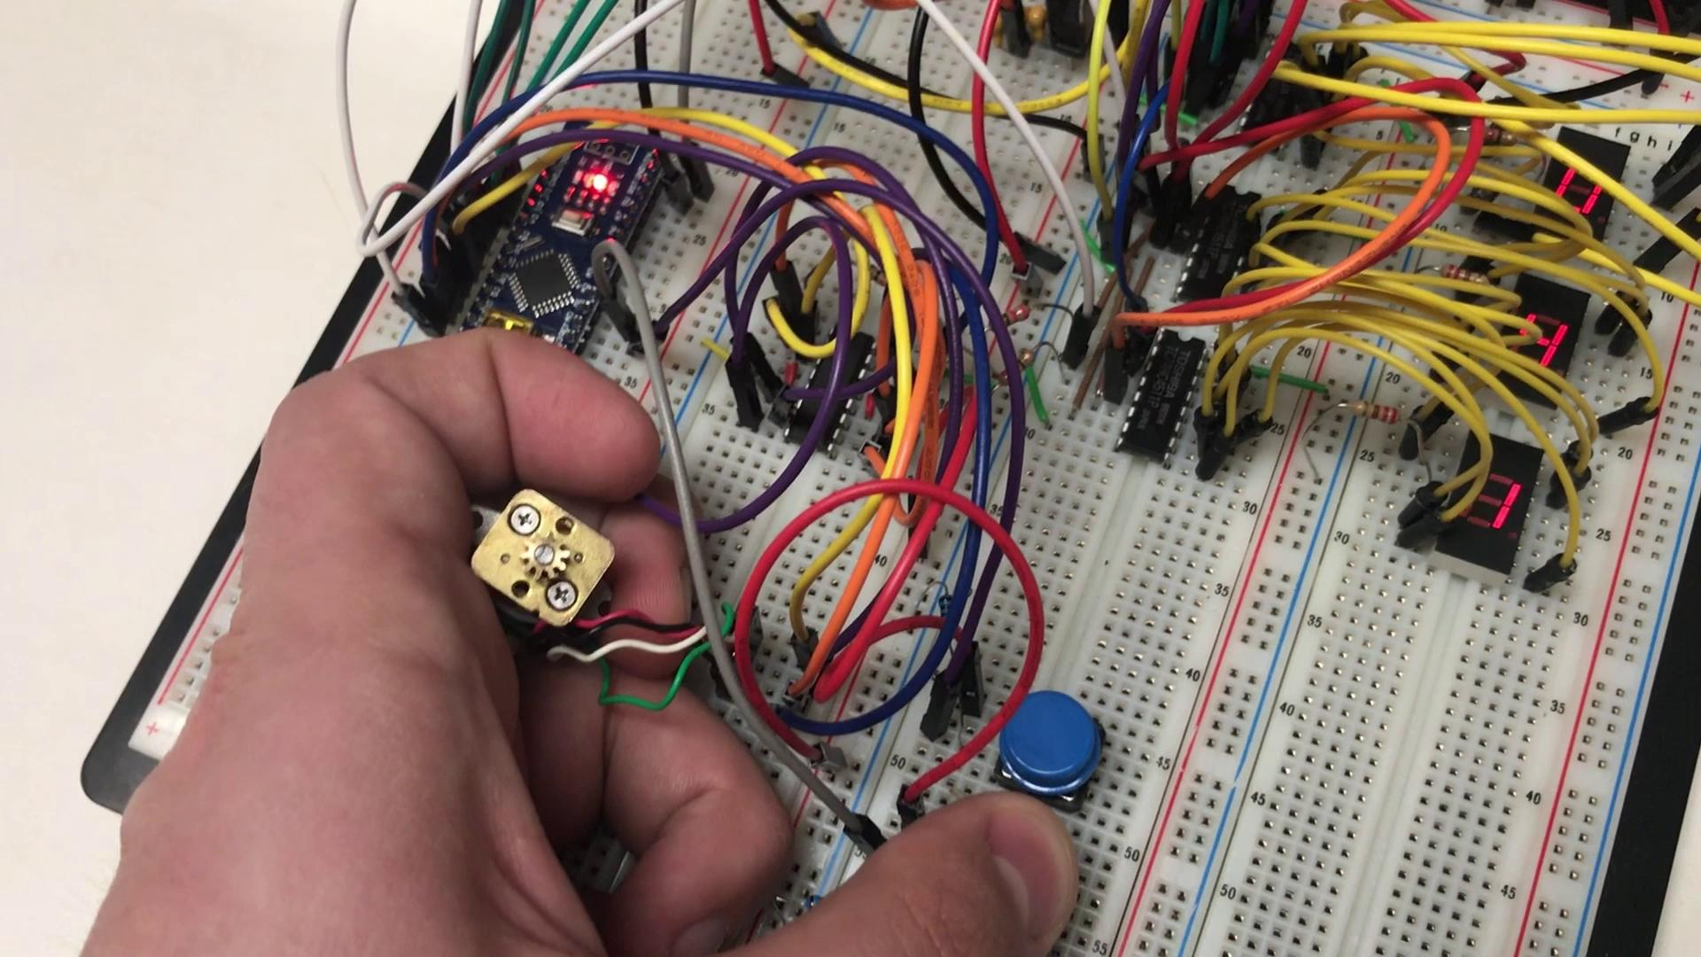
Electronic Actuation -
Results to date
Notes:
Add Pictures of our prototype. Or a short video of the tip bending from manually pulling a wire. Or motor rotation video.

Slide 9
Future Prototype Questions
How can we fit all the components in the handle?
How can we achieve multiplane actuation?
How can we readout the angle of the tip?

Slide 10
